Slide 1


Azərbaycan Dövlət Neft və Sənaye Universiteti

Slide 2
The construction of computer circuits is based on the branch of mathematics and symbolic logic called Boolean logic.
This area of mathematics deals with rules for manipulating the two logical values true and false.
It is used to construct circuits that perform operations such as
Adding numbers
Comparing numbers
Fetching instructions
These ideas are part of the branch of computer science known as hardware design, also called logic design.
Boolean Logic and Gates

Slide 3
It is easy to see the relationship between Boolean logic and computer design:
the truth value true could represent the binary value 1
the truth value false could represent the binary value 0
Thus anything stored internally as a sequence of binary digits can also be viewed as a sequence of the logical values true and false, and these values can be manipulated by the operations of Boolean logic.
Boolean Logic

Slide 4
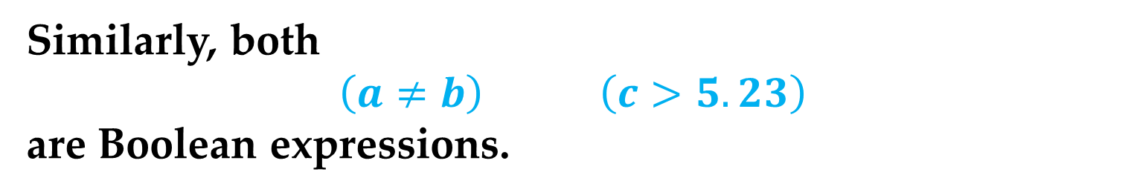
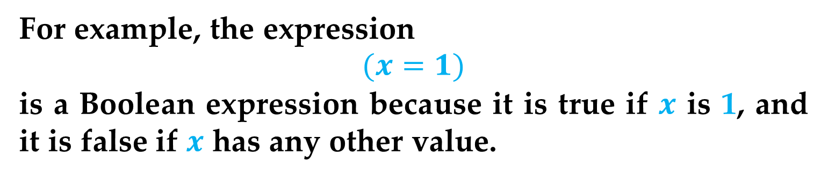
Let us define a Boolean expression as any expression that evaluates to either true or false.
For example, the expression
$$(x=1)$$
is a Boolean expression because it is true if $x$is 1, and it is false if $x$has any other value.
Similarly, both
$$\left(a≠b\right) \left(c>5.23\right)$$
are Boolean expressions.
In Boolean logic, the operations used to construct Boolean expressions are AND, OR, and NOT, and they map a set of (true, false) values into a single (true, false) result.
Boolean Logic

Slide 5
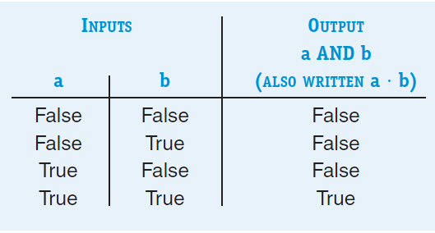
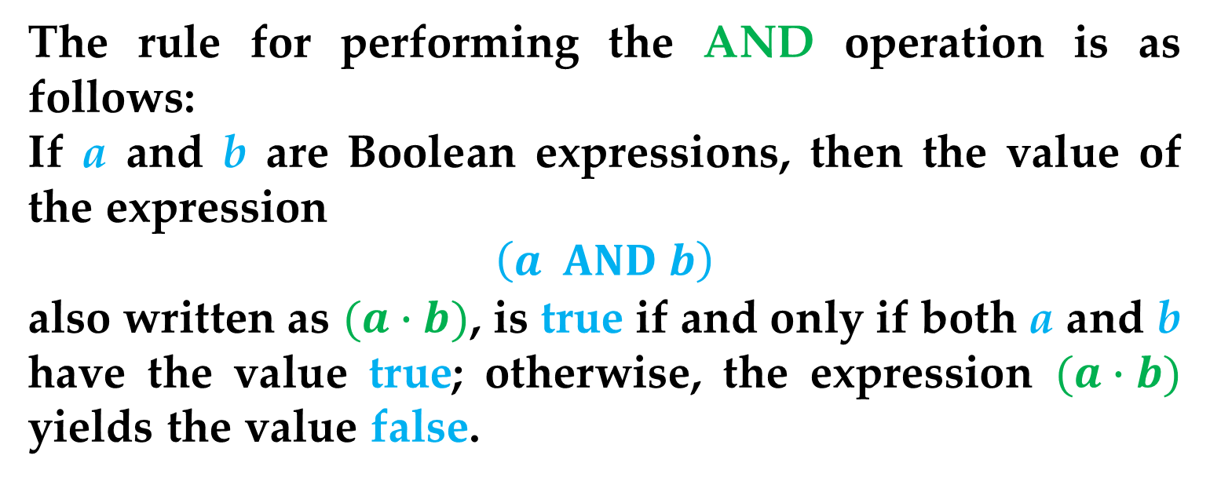
The rule for performing the AND operation is as follows:
If aand bare Boolean expressions, then the value of the expression
$$\left(a AND b\right)$$
also written as $(a∙b)$, is true if and only if both aand bhave the value true; otherwise, the expression $(a∙b)$yields the value false.
This idea can be expressed using a structure called a truth
table, shown next.
Boolean Logic

Slide 6
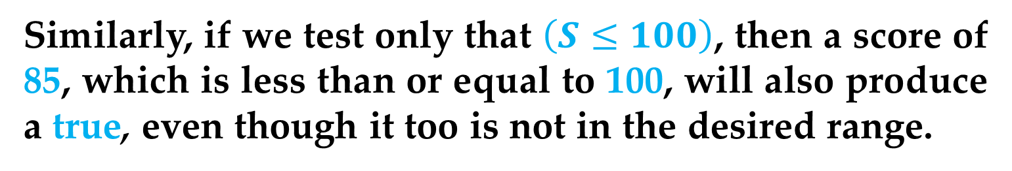
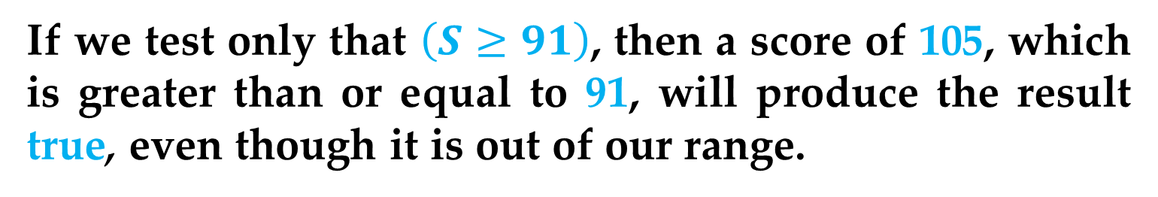
To illustrate the AND operation, imagine that we want to check whether a test score S is in the range 91 to 100 inclusive.
We wish to develop a Boolean expression that is true if the score is in the desired range and false otherwise.
But we cannot do this with a single comparison.
If we test only that $\left(S≥91\right)$, then a score of 105, which is greater than or equal to 91, will produce the result true, even though it is out of our range.
Similarly, if we test only that $\left(S≤100\right)$, then a score of 85, which is less than or equal to 100, will also produce a true, even though it too is not in the desired range.
Boolean Logic

Slide 7
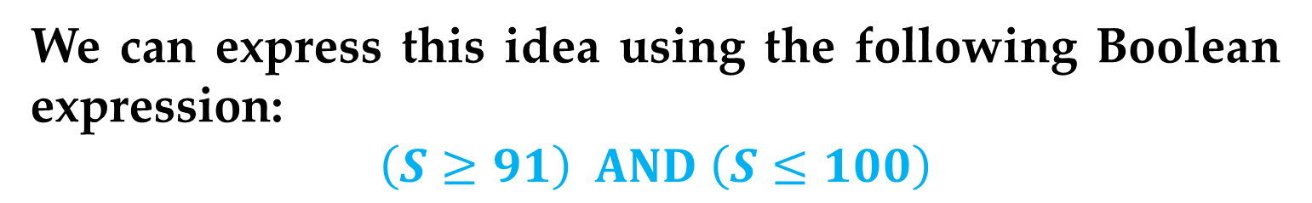
Instead, we need to determine whether the score S is greater than or equal to 91 AND whether it is less than or equal to 100.
Only if both conditions are true can we say that S is in the desired range.
We can express this idea using the following Boolean expression:
$$\left(S≥91\right) AND \left(S≤100\right)$$
Each of the two expressions in parentheses can be either true or false depending on the value of S.
However, only if both conditions are true does the expression evaluate to true.
Boolean Logic

Slide 8
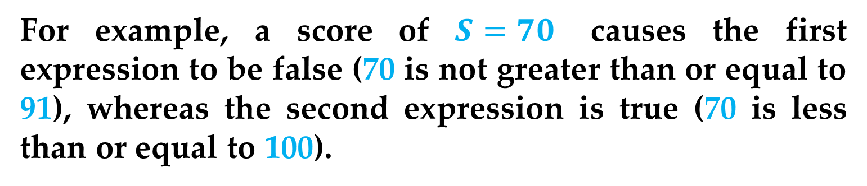
For example, a score of $S=70$causes the first expression to be false (70 is not greater than or equal to 91), whereas the second expression is true (70 is less than or equal to 100).
The truth table below shows that the result of evaluating (false AND true) is false.
Thus, the overall expression is false, indicating (as expected) that 70 is not in the range 91 to 100.
Boolean Logic

Slide 9
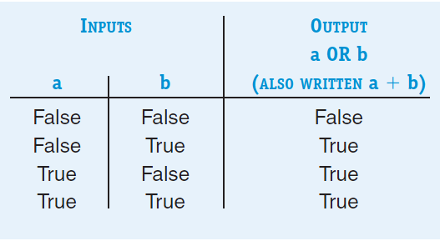
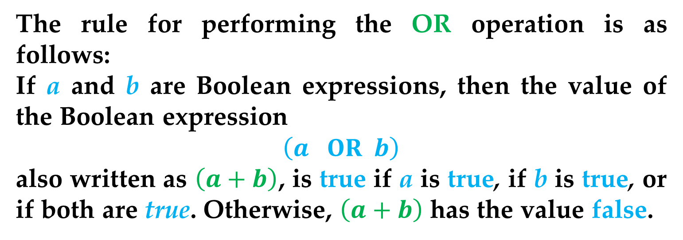
The rule for performing the OR operation is as follows:
If aand bare Boolean expressions, then the value of the Boolean expression
$$\left(a OR b\right)$$
also written as $\left(a+b\right)$, is trueif ais true, if bis true, or if both are true. Otherwise, $\left(a+b\right)$ has the value false.
The truth table for OR is shown next.
Boolean Logic

Slide 10
To see the OR operation at work, imagine that a variable called major specifies a student’s college major.
If we want to know whether a student is majoring in either math or computer science, we cannot accomplish this with a single comparison.
The test
(major = ‘math’)
omits computer science majors, whereas the test
(major = ‘computer science’)
leaves out the mathematicians.
Boolean Logic

Slide 11
Instead, we need to determine whether the student is majoring in either math or computer science (or perhaps in both).
This can be expressed as follows:
(major = ‘math’) OR
(major = ‘computer science’)
If the student is majoring in either one or both of the two disciplines, then one or both of the two terms in the expression is true.
Referring to the truth table for OR, we see that
(true OR false), (false OR true), and (true OR true)
all produce the value true.
Boolean Logic

Slide 12
However, if the student is majoring, for example, in English, both conditions are false.
As the truth table for OR illustrates, the value of the expression
(false OR false) is false
meaning that the student is not majoring in either math or computer science.
Boolean Logic

Slide 13
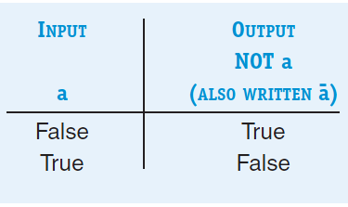
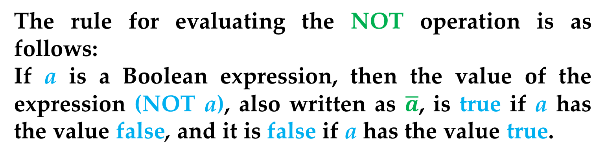
Unlike AND and OR, which require two operands and are therefore called binary operators, NOT requires only one operand and is called a unary operator.
The rule for evaluating the NOT operation is as follows:
If ais a Boolean expression, then the value of the expression (NOT a), also written as $\overline{a}$, is trueif ahas the value false, and it is falseif ahas the value true.
The truth table for NOT is shown next
Boolean Logic

Slide 14
For example, the expression
(GPA > 3.5)
is true if your grade point average is greater then 3.5.
The expression
NOT (GPA > 3.5)
is true only under the reverse conditions, that is when your grade point average is less than or equal to 3.5.
Note that besides AND, OR, and NOT, there are other Boolean operators such as XOR, NOR, and NAND.
Boolean Logic

Slide 15
Why have we introduced these Boolean operations in the first place?
In fact, the fundamental building blocks of a modern computer system (the objects with which engineers actually design) are not the transistors introduced, but the gates that implement the Boolean operations AND, OR, and NOT.
Boolean Logic

Slide 16
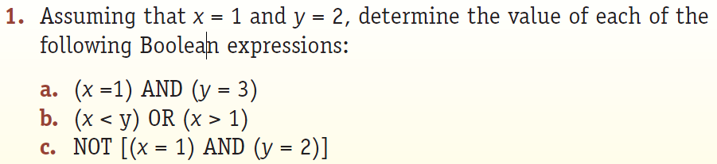
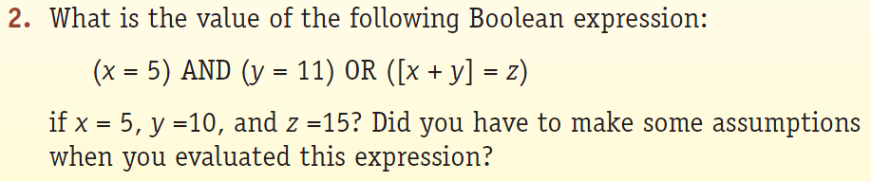
Practice Problems

